Slide 1
lost data with windows
Check sender’s list , When ?
  Timestamp and timeout
    Associate each segment in the list a timestamp
    After more than one RTT, resend
  Numbering segments
    Receiver sends a NAK
How resent segment count against available window?
  Dilemma: original segment is lost? ACK is lost?
  Presume receiver discard duplicated segments
  Same answer in both cases: do not.

Slide 2
Recovery of lost data segments with windows
What if a permission message is lost?
  No data will be received
Resend permission message?
  May get twice as much
  Incremental value is fragile -> cumulative total is better
  Similar with “in” and “out” pointer in bounded-buffer
Rate-matching problem
  Blizzard of packets arising from a newly-opened window
  Need cooperation between end-to-end protocol & network forwarders

Slide 3
5. Assurance of stream order
Stream transport protocol (virtual circuit)
  Series of elements be delivered in order
  Additional assurances
    E.g. no missing, no duplicate, data integrity
  Lock-Step ?
    Not good for large quantities of data
    Stream protocol needs overlapped transmission
  use a serial number to indicate position
    ACK , but in which strategy ?

Slide 4
When out of order…
1 Receiver： only ACK in order packets, discards others
  Waste of bandwidth
2 ACK every packet and hold early packets in buffer, release the buffer when all in order
  Need using large buffer when waiting for a bad packet
3 Combine the two above
  Discard if buffer is full
  New problem: how much buffer?
Speedup for common case
  NAK to avoid timeout
  If NAKs are causing duplicates, stop NAKs

Slide 5
Closing of connections
Open a stream
  Create a record to keep track of which elements --- have been sent, received, acknowledged
Close a stream
  When finish, it needs to report an end-of-stream
  Both ends need to agree last element is OK and then close
  1. Alice sends close request to Bob with stream record ID
  2. Bob checks and agrees, sends a close ACK
  3. Alice receives ACK, turn off sender, discard record
  4. Alice sends “all done” to Bob
  5. Bob receives “all done” and discard stream record
What if duplicate?

Slide 6
6. Assurance of jitter control
Real-time
  Reliability <<< timely delivery
        A few error in a movie may not be noticed
  Jitter: variability in delivery time
Strategy
  Basic: delay all arriving segments

Slide 7
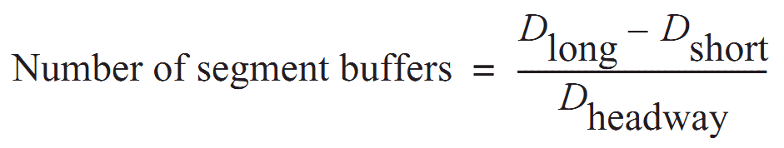
6. Assurance of jitter control
Measure the distribution of delays in a chart showing delay time V.S. frequency of that delay
Choose an acceptable frequency of delivery failure
Determine D_{long} that longer than 99% delay
Determine the shortest delay, D_{short}
Calculate number of segment buffer:
  D_{headway} is average delay between arriving segments

Slide 8
7. Assurance of authenticity and privacy
Internet is dangerous
  Hostile intercepts and maliciously modifies packets
  Violate a protocol with malicious intent
Key-based mathematical transformations
  Sign and verify: establish the authenticity of the source and integrity of contents
  Encrypt and decrypt: maintain privacy of contents
Consideration
  False sense of security, worse than no assurance

Slide 9
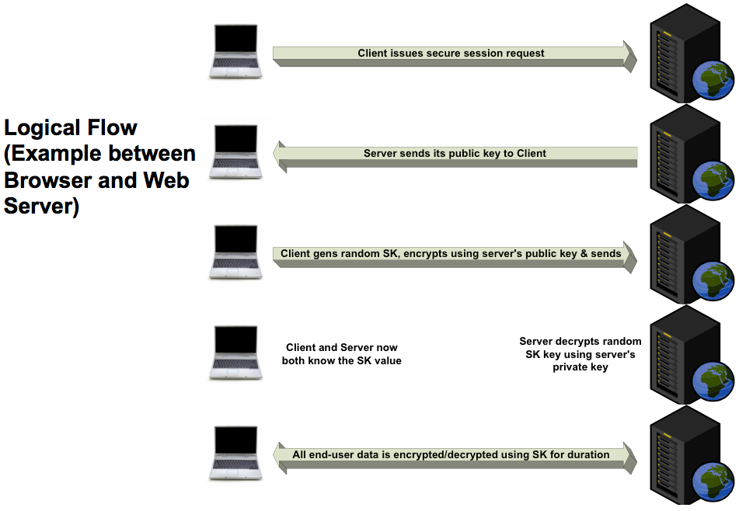
SSL: Simple Protocol

Slide 10
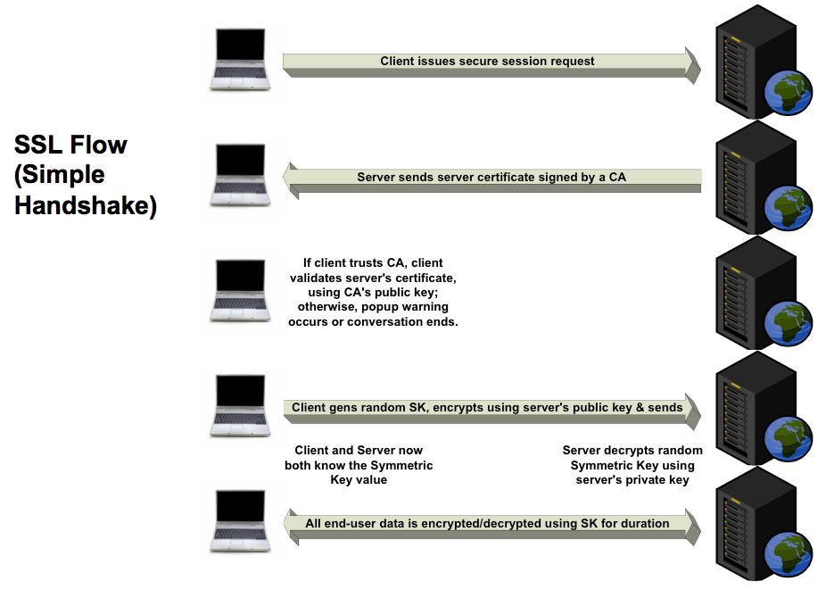
SSL: Simple Hand-shake Protocol

Slide 11
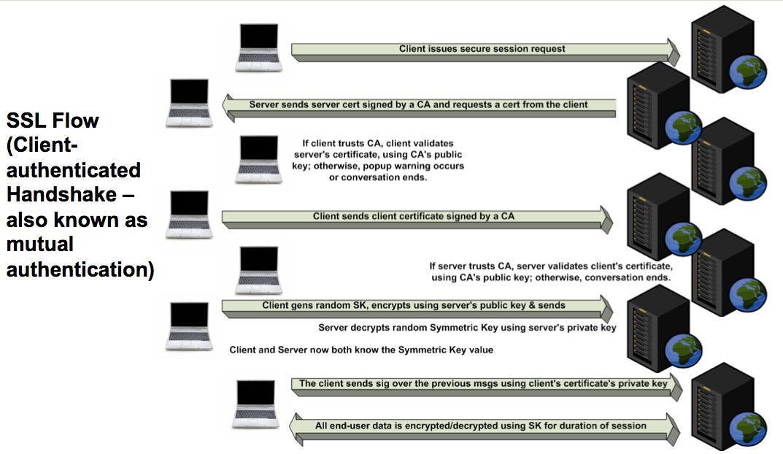
SSL: Authenticated Handshake

Slide 12
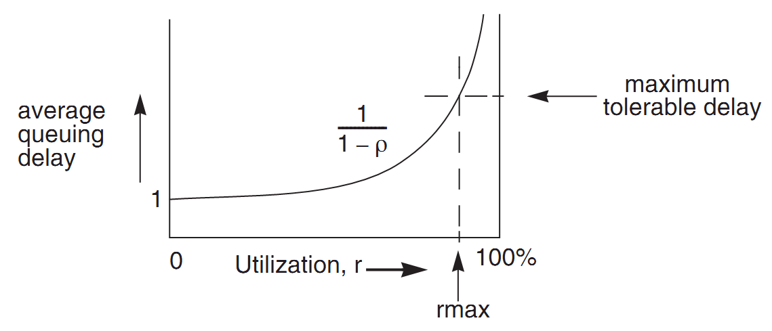
Congestion control
several statistically independent sources demand → A shared resource
Load >> capacity
Notes:
-→there will be fluctuations in the arrival of load, and thus in the length of queue and time spent waiting

Slide 13
Managing shared resources
Overload is inevitable, but how long does it last?
  A queue handles short bursts by time-averaging with adjacent periods when there is excess capacity
  Very longer >> service time, then may >> max delay, which is called congestion
Congestion
  temporary or chronic
  Stability of offered load
    Large number of small source v.s. small number of large source
Congestion collapse
  Competition for a resource sometimes leads to wasting of that resource (Sales & checkout clerks)

Slide 14
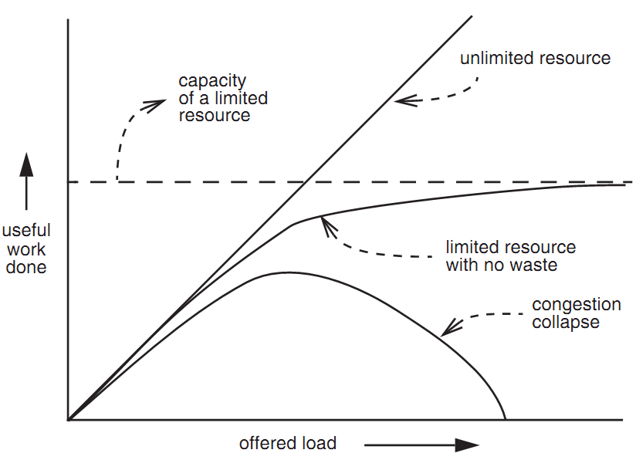
Congestion collapse

Slide 15
Managing shared resources
2 ways to overcome congestion
  Increase the capacity of the resource
  Reduce the offered load: not go away, just delay
Intended load
  Would have been offered in the absence of control
Congestion control system
  Control point & feedback system
  Delay in feedback path leads to oscillations in load and in useful work done
  E.g. more checkout clerks in store, or “please wait” in calling

Slide 16
Resource management in network
Shared resources
  Communication links
  Processing & buffering capacity of the packet forwarders
1. There is more than one resource
2. It is easy to induce congestion collapse
3. There are limited options to expand capacity
4. The options to reduce load are awkward
  Long feedback path to a distant control point
  Capability of reducing load, e.g. stream video
  Willing to cooperate
Decentralization!

Slide 17
Retrofitting TCP
1. Slow start: one packet at first, then double until
  Sender reaches the window size suggested by the receiver
  All the available data has been dispatched
  Sender detects that a packet it sent has been discarded
2. Duplicate ACK
  When receiver gets an out-of-order packet, it sends back a duplicate of latest ACK
3. Equilibrium
  Additive increase & multiplicative decrease
4. Restart, after waiting a short time

Slide 18
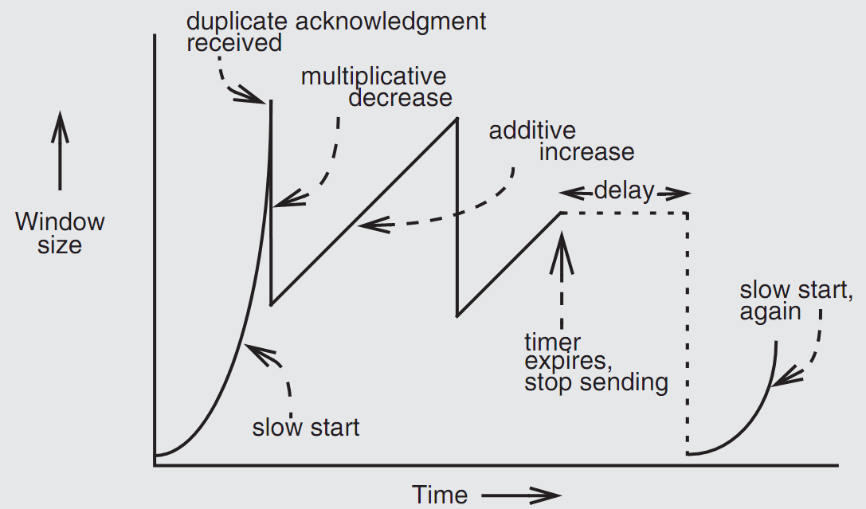
Retrofitting TCP

Slide 19
Cross-layer cooperation: feedback
Source quench
  Send control message to source, which causes extra load
Set flag to notify the destination then send back
  No extra packet needed: piggyback
  More hazardous: destination get first
Discard a packet
  Source will notice the lack (or by NAK)
  Which packet to drop?
    Tail drop, random drop, front drop, early drop
    RED (Random early detection)

Slide 20
Cross-layer cooperation: control
What to do after detecting a congestion?
1. Set timer carefully
  Update RTT of each packet and estimate next RTT
  Exponential backoff when timeout
  Use RTT estimate back when get through
2. Manage the flow control window
  Large as the bottleneck
    Force “window size = round-trip time × bottleneck data rate”
  Sender should restrain and shrink the window size
    No larger than necessary

Slide 21
Other ways of controlling congestion in network
Overprovisioning
  Configure each link to 125% or more
  Works on interior links of a large network, where each client only has a tiny fraction of the load
  Large clients are stable and predictable
  Problems:
    Odd events can disrupt statistical independence→
    May just move the congestion to a different link
    Statistical averaging stops working at the edge
    Adaptive behavior of users can interfere with the plan
Notes:
Odd events --→ earthquake cause a lot of connections to the area

Slide 22
Other ways of controlling congestion in network
Pricing
  Coincides interest of a user with that of network
    Let the invisible hand take over
  If resource exceeds its capacity, clients will bid up the price
  Clients will defer their use of resource until it’s cheaper
  Problems:
    Making pricing mechanism work on the short time-scales
    Invisible hands requires minimal barriers to entry by alternate suppliers
Congestion control is still an active research topic

Slide 23
Retrofitting TCP
(hidden)
The only way of ACK:
  “I have received all the bytes up to X”
No way to say:
  “I am missing bytes Y through Z”
  Resend packets ever since

Slide 24
Retrofitting TCP
(hidden)
Goals
  Change the implementation without changing the data formats
  Allow new and old implementations to interoperate
  New implementations could gradually replace the old
Works by having the sender tinker with the size of the ﬂow control window

Slide 25
Delay revisited
Propagation, transmission, processing, queuing
Congestion control and flow control, not the 5th delay
  Just an example of transmission delay ( in different layers)
Each layer can impose any or all of the four delays
  Processing delay
    Link layer: calculating checksums
    Network layer: looking up forwarding table
    End-to-end layer: compressing, segmenting, reassembling

Slide 26
Delay revisited
Transmission delay
  Link layer: time of sending bits on a link
  Network layer: choose routes -> number of hops
  End-to-end layer: pacing effect caused wait for permission
Queuing delay
  Link layer: transmission delay can create queues
  Network layer: several packets arrive at same time
  End-to-end layer: waiting for flow control or congestion control permission
Propagation delay
  Link layer: take the most

Slide 27
Wrapping up networks
Is all of this stuff really needed?
  It depends on the application and network itself
For a single point-to-point link
  No network layer needed
For A short reliable link
  End-to-end layer: no need for resend
A single broadcast link network, e.g. system BUS
  Network layer : each receiver’s Network layer discard packets which is to other station
  Reorder is not a problem

Slide 28
Case study: mapping Internet to Ethernet
Listen-before-sending rule, collision
Ethernet: CSMA/CD
  Carrier Sense Multiple Access with Collision Detection
Ethernet type
  Experimental Ethernet, 3mpbs
  Standard Ethernet, 10 mbps
  Fast Ethernet, 100 mbps
  Gigabit Ethernet, 1000 mbps

Slide 29
Overview of Ethernet
A half duplex Ethernet
  The max propagation time is less than the 576 bit times, the shortest allowable packet
  So that two parties can detect a collision together
    Collision: wait random first time, exponential backoff if repeat
A full duplex & point-to-point Ethernet
  No collisions & the max length of the link is determined by the physical medium

Slide 30
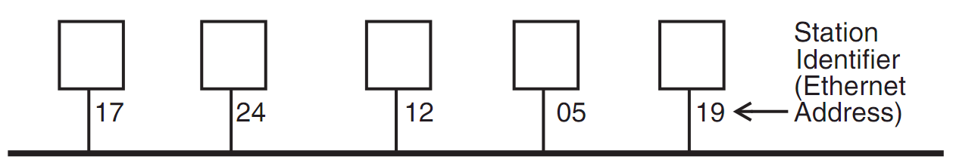
Broadcast aspects of Ethernet
Broadcast network
  Every frame is delivered to every station
  (Compare with forwarding network)
ETHERNET_SEND
  Pass the call along to the link layer
ETHERNET_HANDLE
  Simple, can even be implemented in hardware

Slide 31
Broadcast aspects of Ethernet
procedure ETHERNET_HANDLE (net_packet, length)
destination ← net_packet.target_id
if destination = my_station_id
then
GIVE_TO_END_LAYER (net_packet.data,
net_packet.end_protocol,
net_packet.source_id)
else
ignore packet
no need to do any forwarding

Slide 32
Broadcast aspects of Ethernet
procedure ETHERNET_HANDLE (net_packet, length)
destination ← net_packet.target_id
if destination = my_station_id
or destination = BROADCAST_ID
then
GIVE_TO_END_LAYER (net_packet.data,
net_packet.end_protocol,
net_packet.source_id)
else
ignore packet

Slide 33
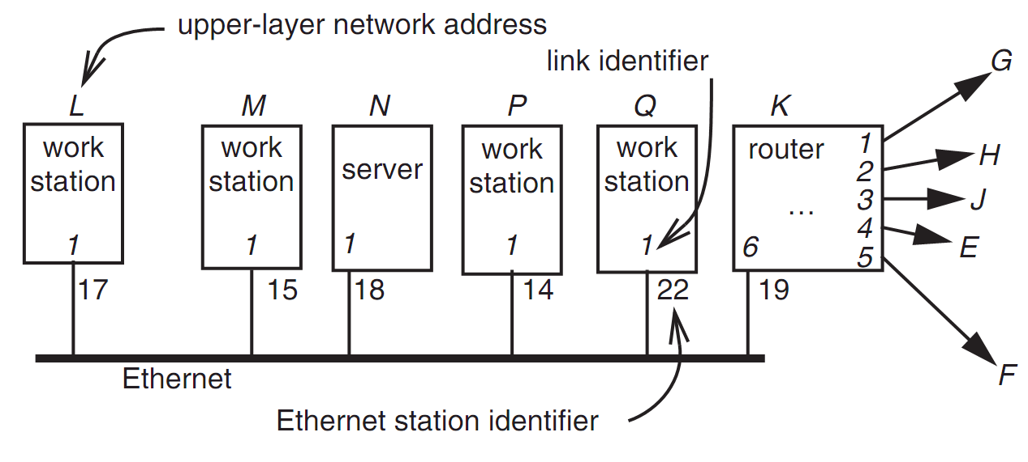
Layer mapping: attach Ethernet to forwarding network
15
L sends a RPC to N by sending to station 18 of link 1
L sends a RPC to E by sending to K, E may have 15 as address

Slide 34
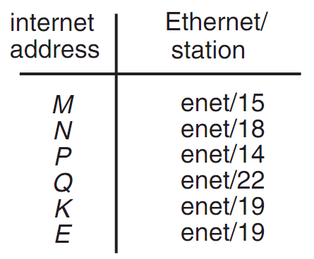
Layer mapping
The internet network layer
  NETWORK_SEND (data, length, RPC, INTERNET, N)
  NETWORK_SEND (data, length, RPC, ENET, 18)
L must maintain a table

Slide 35
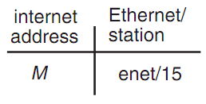
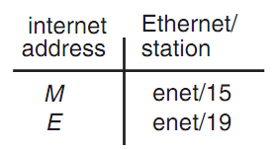
ARP (Address Resolution Protocol)
NETWORK_SEND (“where is M?”, 11, ARP, ENET, BROADCAST)
NETWORK_SEND (“M is at station 15”, 18, ARP, ENET, BROADCAST)
L ask E’s Ethernet address, E does not hear the Ethernet broadcast, but the router at station 19 does, and it sends a suitable ARP response instead
Manage forwarding table as a cache

Slide 36
War stories: surprises in protocol design
Fixed Timers Lead to Congestion Collapse in NFS
Autonet Broadcast Storms
Emergent Phase Synchronization of Periodic Protocols
Wisconsin Time Server Meltdown

Slide 37
Congestion collapse in NFS
Using at-least-once with stateless interface
Persistent client: repeat resending forever
Server: FIFO
When Timeout, client resend
Re-execute the duplicate request and waste time ( because stateless)
  the queue becomes longer
Lesson: Fixed timers are always a source of trouble, sometimes catastrophic trouble

Slide 38
Autonet broadcast storms
Designed by DEC to handle broadcast elegantly
  Physical layer: point-to-point coaxial cables
Network as a tree
  Broadcast packet first to root then down
  Nodes accepted only packets going downward
    No duplicate broadcast
  Problem: every once in a while, the network collapsed with a storm of repeated broadcast packets
Lesson: Emergent properties often arise from the interaction of apparently unrelated system features operating at different system layers, in this case, link-layer reflections and network-layer broadcasts.

Slide 39
Emergent phase synchronization of periodic protocols
Periodic polling
  E.g. picking up mail, sending “are-you-there?”
  A workstation sends a broadcast packet every 5 minutes
  All workstations try to broadcast at the same time
Each workstation
  Send a broadcast
  Set a fixed timer
Lesson: Fixed timers have many evils. Don’t assume that unsynchronized periodic activities will stay that way

Slide 40
Wisconsin time server meltdown
NETGEAR added a feature to wireless router
  Logging packets -> timestamp -> time server (SNTP) -> name discovery -> 128.105.39.11
  Once per second until receive a response
  Once per minute or per day after that
Wisconsin Univ.
  On May 14, 2003, at about 8:00 a.m
  From 20,000 to 60,000 requests per second, filtering 23457
  After one week, 270,000 requests per second, 150Mbps

Slide 41
Wisconsin time server meltdown
Lesson(s)
  Fixed timers again
  Fixed Internet address
  The client implements only part of a protocol
    There is a reason for features such as the “go away” response in SNTP

